Slide 1
Credit Card Approval Prediction
Team:
Atluri Vinod
Rushyanthi Vullangula
Sattenapalli Sai Sree
Thota Dharani
Sana Yedukondalu

Slide 2
Introduction
Machine learning system to predict credit card approval using applicant information.
Credit cards are widely used for financial transactions. Banks receive a large number of applications every day. Manually reviewing each application is time-consuming and may lead to inconsistent decisions.
This project uses Machine Learning to automatically predict whether a credit card application should be approved or rejected based on applicant information.

Slide 3
Problem Statement
• Manual approval is slow • Human errors • Need faster, consistent decisions
Manual approval process is slow.
Human errors may occur.
Large number of applications.
Risk of approving ineligible applicants.
Time-consuming verification process.

Slide 4
Objectives
Predict approval Reduce manual work Improve accuracyAutomate the approval process.
Predict approval status accurately.
Reduce manual effort.
Improve decision-making.
Provide faster results.

Slide 5
Technology Stack
Python Flask HTML/CSS Pandas Scikit-learn XGBoost GitHub

Slide 6
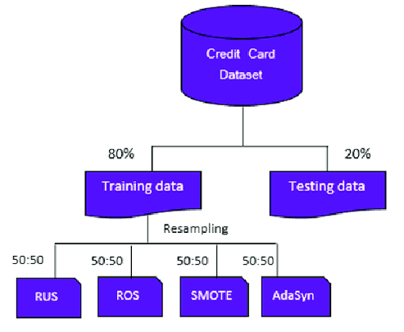
System Workflow
Dataset → Preprocessing → Model Training → Prediction → Flask Web App

Slide 7
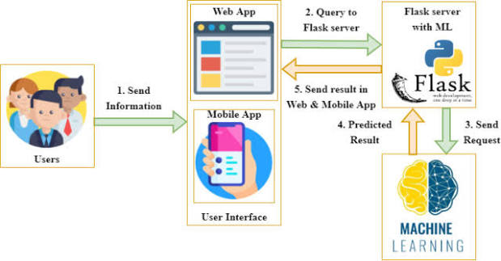
Architecture
User → Web App → Flask → ML Model → Prediction Result

Slide 8
Results
• Fast prediction • Automated process • Improved consistency

Slide 9
Future Scope
• Cloud deployment • Mobile app • Bank API integration

Slide 10
Thank You
Questions?

